Slide 1

Final Project Presentation
Department of Electrical and Computer Engineering
Tandon School of Engineering, New York University
Present By: Haoze He
NYUID: hh2537

Slide 2
01 / Executive Summary
02 / Approach
Agenda
03 / Main Results
04 / Observation & Conclusion
05 / GitHub Link
Notes:
More experiments results will be added for Downpour.

Slide 3
Executive Summary
Asynchronized Stochastic Gradient Descent
Advantages
Disadvantages
High accuracy
Waste time and lead to slow converge
Synchronous Stochastic Gradient Descent
Advantages
Disadvantages
Time saving
Lower accuracy
Notes:
Non-Blocking Synchronize Stochastic Gradient Descent: Achieve accuracy as high as ASSGD and similar time using as SSGD
1:Hardware ApproachI can start from simple ones using existing resources: the NYU Greene HPC clusters mi50. To get computing resources shourtly, I use multiple cpu-nodes as workers and the parameter server instead of multiple-gpus(will be hard to get resources).
2:Code Approach: Using torch.distributed and mpi as backend to build the communication scheme. Run the code on NYU HPC with multiple nodes. Single cpu/task per node.
4:Model used: I utilize RESNET50 and CIFAR10 and models and dataset to test the communication shceme.
3:Performance Test: We use PyTorch programs to observe the effect and test our method and measure the TTA as well as the final accuracy comparing to other method such as ASGD, HOGWILD(SGD), Downpour. Timing(TTA) and accuracy are tested.

Slide 4
Approach A – Synchronize SGD
Batch size =256
Cons: Waste time
: Communication time
Worker 1
0
Free
1
Free
Worker 2
0
Free
1
Free
Parameter Server
Param. Version
0
1
Worker 3
0
1
Worker 4
0
Free
1
Free

Slide 5
Approach B – Asynchronized SGD
Batch size =256
Cons: Lower Accuracy
: Communication time
Worker 1
0
2
6
Worker 2
0
1
3
Parameter Server
Param. Version
4
6
3
1
5
0
2
Worker 3
0
4
Worker 4
0
5

Slide 6
Approach C – Non-Block SGD
Batch size = 256
Mini-batch size = 32
* : Unfinished part
: Communication time
Worker 1
…
0-01
0-02
0-03
1-06
0-04
1-07
*0-06
0-05
Worker 2
…
1-1
0-01
0-07
1-3
0-08
0-02
1-2
0-03
0-04
0-06
0-05
Parameter Server
Param. Version
…
0
1
Worker 3
…
0-04
1-06
0-01
0-03
*0-05
0-02
1-05
Worker 4
0-03
…
0-04
1-07
0-02
0-05
0-01
*0-06
1-06

Slide 7
Differences – Synchronized SGD and Non-Block SGD
Notes:
More experiments results will be added for Downpour.

Slide 8
Approach - Implementation
Notes:
More experiments results will be added for Downpour.

Slide 9
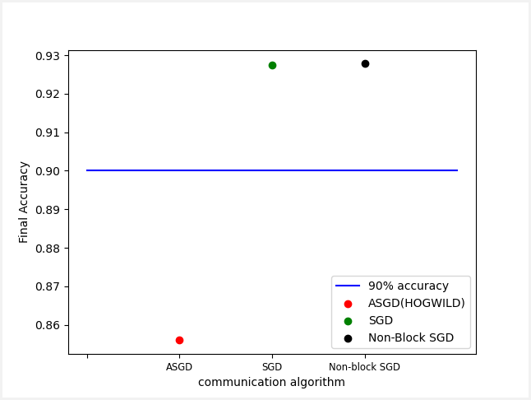
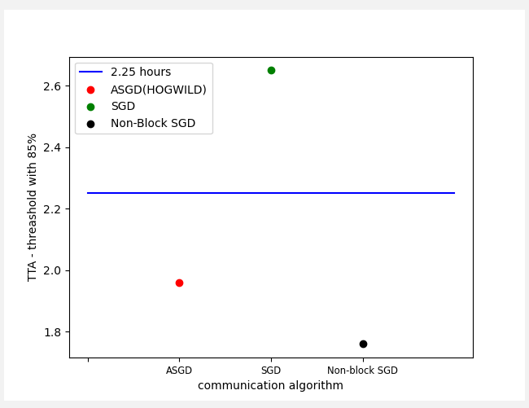
Main Results
Notes:
More experiments results will be added for Downpour.

Slide 10
Observations & Conclusion
Non-blocking SGD has simiar accuracy with SGD and much higher than ASGD
Non-blocking SGD has similar TTA with ASGD and much quicker than SGD
Non-blocking SGD has even better TTA than ASGD when threashold is high enough(85%)

Slide 11
GitHub Link
GitHub Link: https://github.com/HectorHHZ/HPML

Slide 12
THANK YOU!

